Slide 1


Accurate Predictions of Genetic Circuit Behavior from Part Characterization and Modular Composition
Jacob Beal, Noah Davidsohn, Aaron Adler, Fusun Yaman, Yinqing Li, Zhen Xie, Ron Weiss
5th IWBDA
July, 2013

Slide 2
EQuIP: Realizing the Dream
TAL14
TAL14-TAL21
Precise Match!
Active pop. mean MEFL vs time

Slide 3
Outline
Calibrating Flow Cytometry TASBE Method
Building EQuIP Models
Prediction & Validation
[Beal et al., Technical Report: MIT-CSAIL-TR-2012-008, 2012]

Slide 4
First, some metrology…
R1
R2
Output
[R2]
[Output]
Arbitrary Blue
Arbitrary Blue
[R1]
[R2]
Arbitrary Red
Arbitrary Red
Unit mismatch!

Slide 5
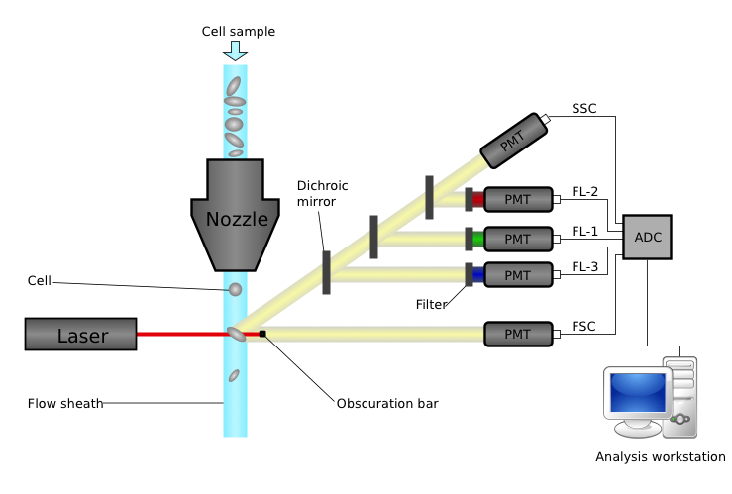
How Flow Cytometry Works
Challenges:
Autofluorescence
Variation in measurements
Spectral overlap
Time Contamination
Lots of data points!
Different protein fluorescence
Individual cells behave (very) differently

Slide 6
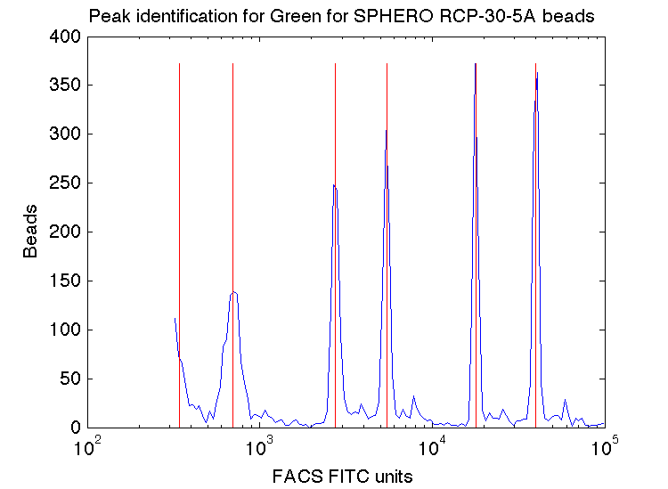
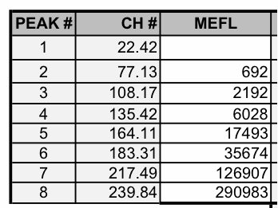
Fluorescent Beads → Absolute Units
SpheroTech RCP-30-5A
Run beads every time: flow cytometers drift up to 20 percent!
Also can detect instrument problems, mistakes in settings

Slide 7
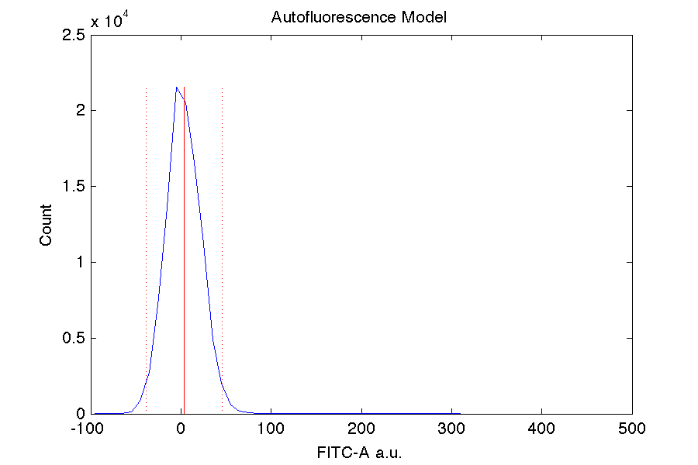
Compensating for Autofluorescence
Negative control used for this

Slide 8
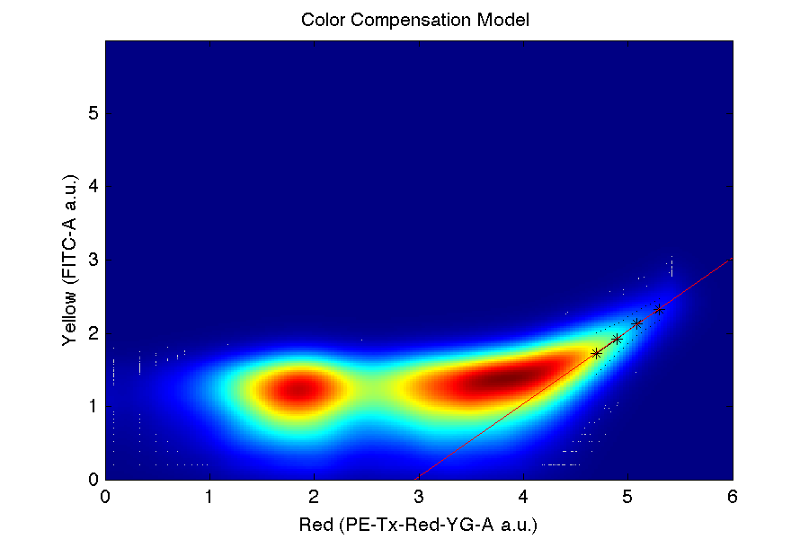
Compensating for Spectral Overlap
Strong positive control used for each color
Note: only linear when autofluorescence subtracted

Slide 9
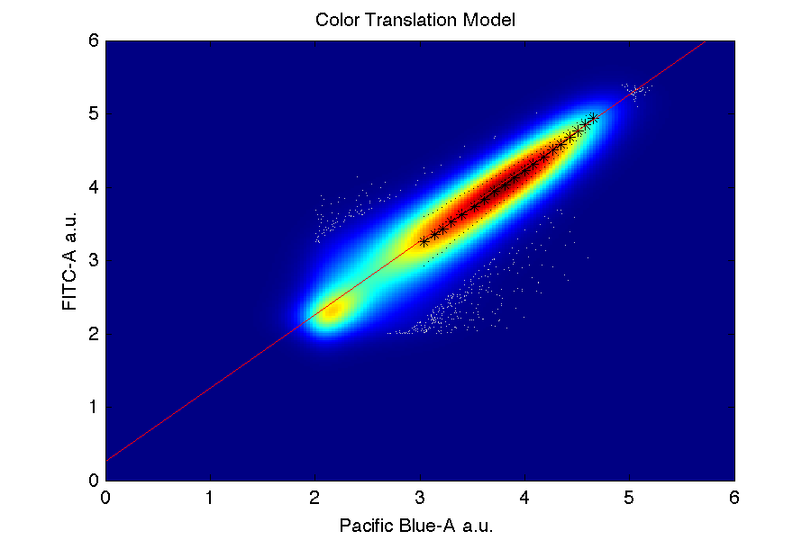
Translating Fluorescence to MEFL
Only FITC channel (e.g. GFP) goes directly
Others obtained from triple/dual constitutive controls
Must have exact same constitutive promoter!
Must have a FITC control protein!

Slide 10
Outline
Calibrating Flow Cytometry
Building EQuIP Models
Prediction & Validation
EQuIP = Empirical Quantitative Incremental Prediction

Slide 11
TASBE Characterization Method
Dox
R1
Output
Dox
pCAG
rtTA3
T2A
VP16Gal4
EBFP2
pCAG
mkate
pCAG
pTRE
pTRE
R1
pUAS-Rep1
EYFP
Transient cotransfection of 5 plasmids
Calibrated flow cytometry
Analysis by copy-count subpopulations

Slide 12
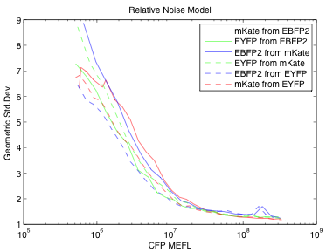
Multi-plasmid cotransfection!?!
Avoids all problems with adjacency, plasmid size, sequence validations
Variation appears to be independent

Slide 13
Result: Input/Output Relations
Transfer curve for TAL 14
Transfer curve for TAL 21
R1 = TAL14
R1 = TAL21

Slide 14
Expression Dynamics
Fraction Active
Mean Expression
Results → division rate, mean expression time, production scaling factor

Slide 15
EQuIP model
Dilution
& decay
Delay
I(t)
P(I,t)
O(t)
+
Model = first-order discrete-time approximation

Slide 16
Outline
Calibrating Flow Cytometry
Building EQuIP Models
Prediction & Validation

Slide 17
EQuIP Prediction
+
Dox
R1
R2
Output
Dox
pCAG
rtTA3
T2A
VP16Gal4
pTRE
EBFP2
pCAG
R1
R2
EYFP
pCAG
mkate
pTRE
pUAS-Rep1
pUAS-Rep2
R1 Device
R2 Device
Dilution
& decay
Delay
Dilution
& Decay
Delay
I(t)
P(I,t)
+
P(I,t)
+
O(t)

Slide 18
Incremental Discrete Simulation
[TAL21]
[TAL14]
[OFP]
TAL14
OFP
TAL14
production
OFP
production
TAL21
state
TAL14
state
OFP
state
time
+
+
production
hour 1
loss
-
-
-
+
+
production
hour 2
loss
…
…
…
-
-
-
production
+
+
hour 46

Slide 19
High Quality Cascade Predictions
1.6x mean error on 1000x range!
TAL14 → TAL21
TAL21 → TAL14
Circles = EQuIP predictions
Crosses = Experimental Data

Slide 20
Contributions
TASBE method calibrates flow cytometry data
Cotransfected test circuits give good models
EQuIP accurately predicts cascade behavior from models of individual repressors
Now for bigger, better circuits on more platforms…

Slide 21


Acknowledgements:
Aaron Adler
Fusun Yaman
Ron Weiss
Noah Davidsohn
Yinqing Li
Zhen Xie

Slide 22
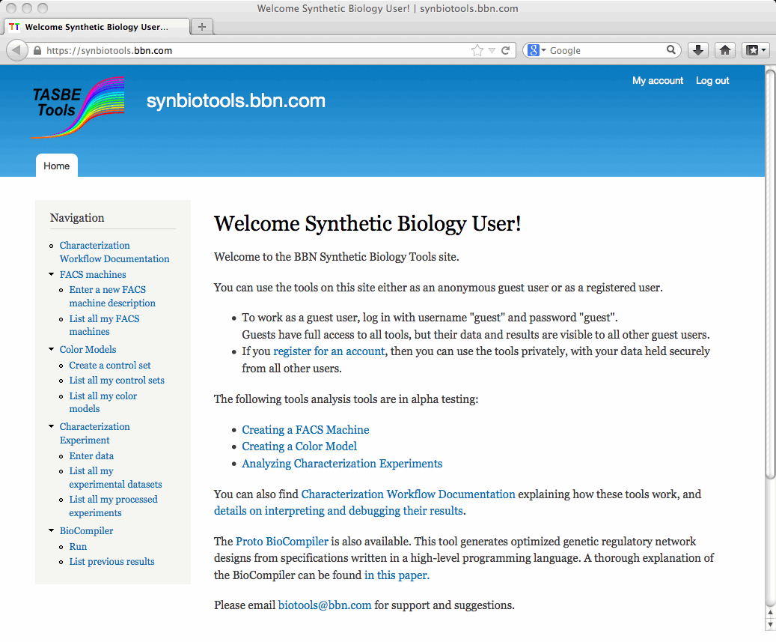
Characterization Tools Online!
https://synbiotools.bbn.com/

